Slide 1
Preserving and Accessing the History of ASIST and Information Science
Digitizing the ASIST Photographic Record
Trudi Bellardo Hahn
November 4, 2013

Slide 2
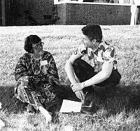
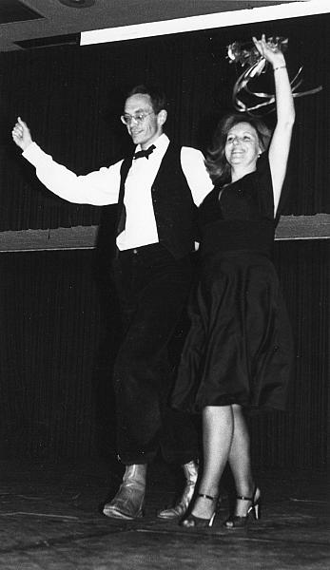
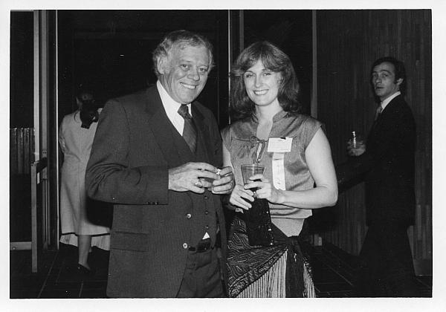
Notes:
Genesis of the idea: my visit to ASIST HQ for the purpose of preparing reminiscences of my own early days in ASIST, for a panel session at the ASIST conference in 2011 [show a couple of pictures from that presentation]
I was startled to see that there were at least 4 packed drawers of photos in a rickety old file cabinet in a storeroom. Not only were the photos not stored particularly well for long-term preservation, nobody but the ASIST staff and me had any idea they were there. Not every association or scholarly society has such a solid collection of its photographs of its leaders, members, conferences, and special invited guest speakers for a period of nearly 60 years.

Slide 3
We chose Gallery, an “open source web based photo album organizer. Gallery gives you an intuitive way to blend photo management seamlessly into your own website whether you're running a small personal site or a large community site.”
Student Team:
Rashmi Giri, Uchechi Ukomadu and Eric Licatovich
Notes:
So I asked an adjunct faculty member at the University of Maryland, Katy Lawley, who was teaching a capstone MIM course in which student teams had to take on “real-world” projects for clients. I described the files of photographs and what we wanted to accomplish with them. The students’ task was to find a suitable platform and they chose Gallery, the version called Gallery3, which Russ Evans, ASIST’s IT consultant, loaded on the ASIST server. The students set it up to receive the photographs and metadata. Dick Hill helped Katy to transfer 4 large heavy boxes of photos from ASIST HQ in Silver Spring to the College Park campus. The students the started the tedious work of digitizing each photo and trying to add whatever metadata they found on the folders the photos were stored in envelope or folders, or on the photos themselves. By the end of the semester, they had it set up, with the architecture and navigation sorted out. They created “albums” by year of conference since that was the type of photo they began with. Later I set up additional albums for individual head shots of members and invited speakers, as well as a separate album for presidents. The student team digitized only a couple of hundred photographs….a small start out of the 2626 that eventually went into the system. But the students’ work was an extremely useful first step that I needed to get me started. Russ continued to provide technical support and troubleshooting for me in the year-long effort to get all the photos scanned and labeled as best I could. That year was a steep learning curve for me in the fine art of scanning!

Slide 4
Issues with this photograph collection
Deliberate damage
  Holes punched
  Names written on the front
  Red markings for cropping (for the ASIS Bulletin)
General unintentional deterioration because of poor storage
Incomplete or absent labeling
The students did not know how to fill in missing data or put the photos in context. They made mistakes, e.g., Tom Bearman
Possible copyright infringement. Use of those produced by commercial photography studios prohibited--although I did use some that were not identified by name and address of the studio. It’s probable that many of those studios no longer exist; the copyright status of the photos is murky—they are orphan works.
Notes:
The scanning and tagging project took 100s of hours over many months. Some issues I encountered with this collection of photographs:
Deliberate damage
Holes punched
Names written on the front
Red markings for cropping (for the ASIS Bulletin)
General unintentional deterioration because of poor storage
Incomplete or absent labeling
The students did not know how to fill in missing data or put the photos in context. They made mistakes, e.g., Tom Bearman
Possible copyright infringement. Use of those produced by commercial photography studios prohibited--although I did use some that were not identified by name and address of the studio. It’s probable that many of those studios no longer exist; the copyright status of the photos is murky—they are orphan works.

Slide 5
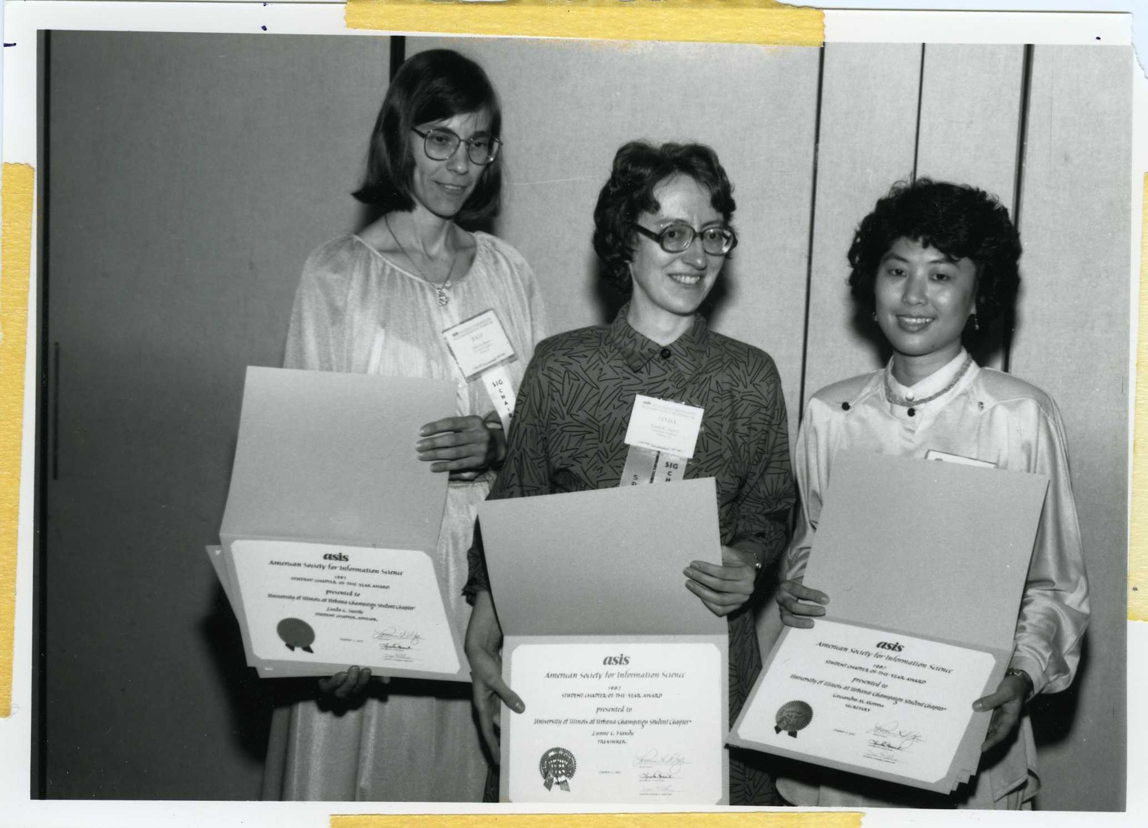
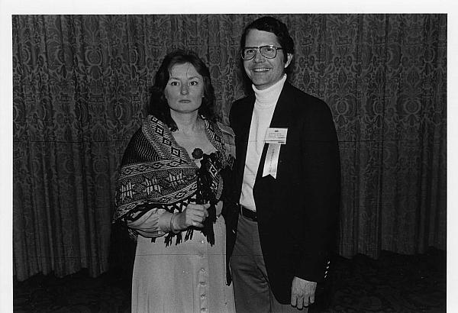
Young individuals who later became leaders in the field and in the association:
Notes:
Now I’d like to show you some of the more remarkable (to me) photos…..starting with candid shots of young persons who later became leaders in the field and in the association. Ralf (Debora) Shaw, Linda Smith, Dudee Chang…. (winning the Student Chapter of the Year award for the University of Illinois in 1987, Toni Carbo and Chuck Davis at the 1978 annual meeting.

Slide 6
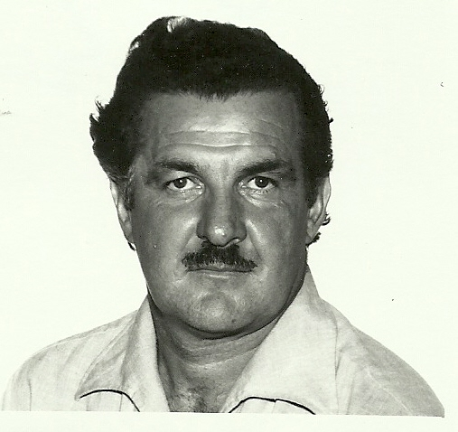
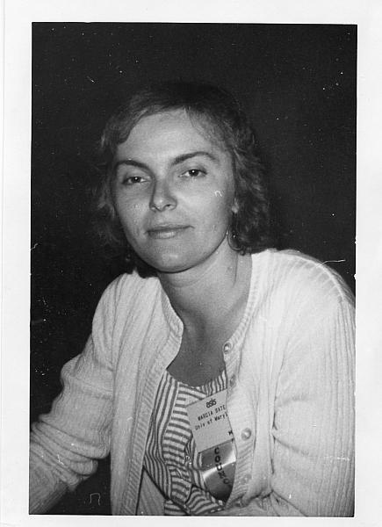
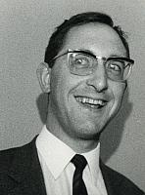
Notes:
More pictures of the way they were: Dagobert Soergel, Tefko Saracevic, Marcia Bates.

Slide 7
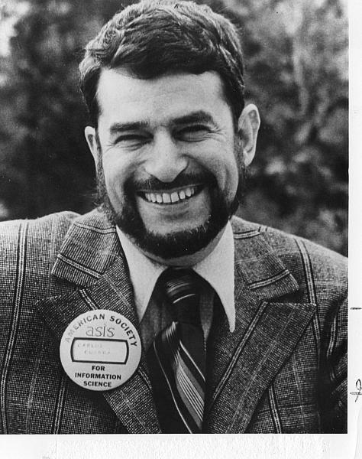
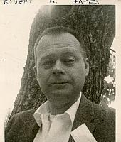
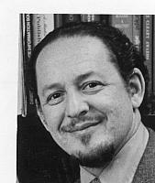
Notes:
Other young professionals who grew up to be extremely influential in the field: Carlos Cuadra, Gene Garfield, Bob Hayes. All three had Ph.D.’s but only one became an academic. That was typical of the membership back in the day.

Slide 8
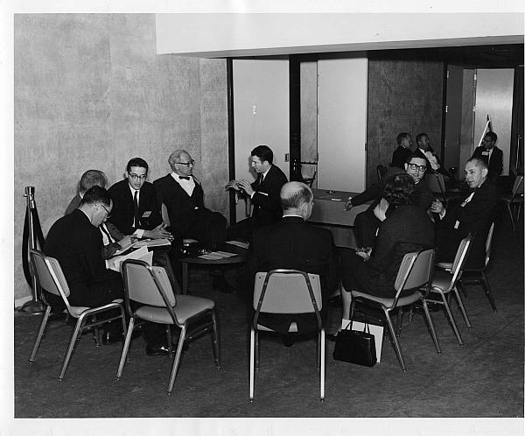
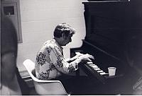
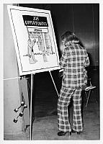
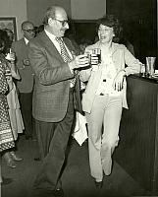
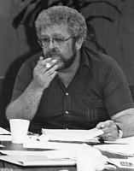
Notes:
You will find photographic evidence of social habits of the time—in the oldest photos from the early days, men dominated the membership (1 in 11 in this pic from 1963), ), being entertained at informal gatherings at Mid-Year (Dave Batty at 76 midyear )smoking & drinking (That’s Sam Beatty chain-smoking at a Board of Directors meeting in the early 1980’s. Esther Horne & Gerry Sophar relaxing at a reception), as well as styles of dress in the mid-70s (mercifully unidentified young woman)

Slide 9
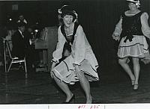
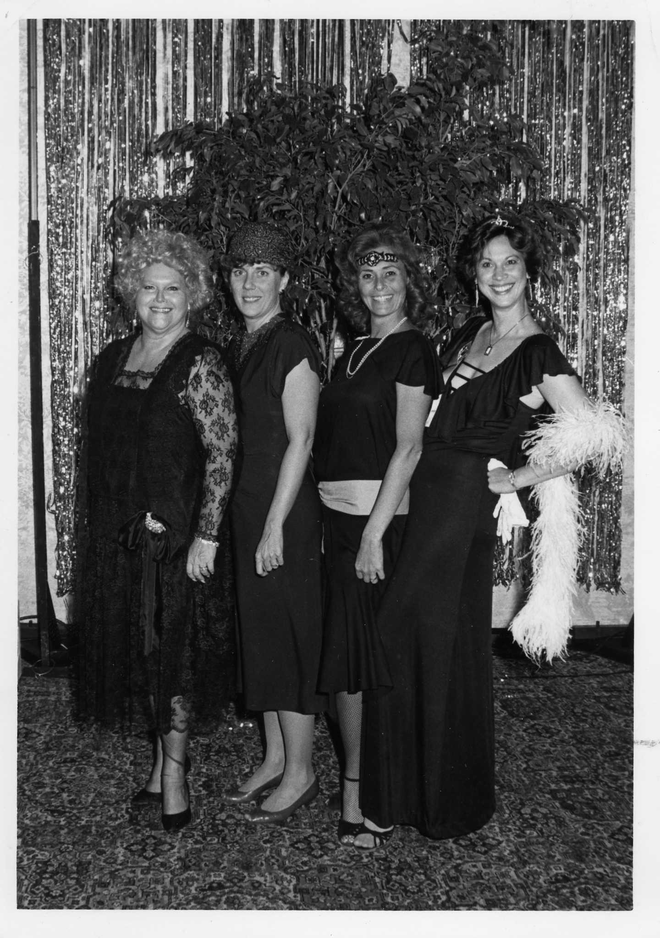
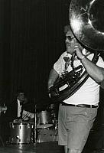
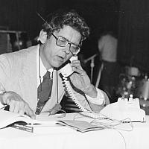
Notes:
The photos capture unique moments in the history of ASIS that will never be repeated, such as the SIG FOLLIES of 1979 (Susan Harvey, Sam Beatty and Allan Pratt) and dressing up for the Annual Banquet in 1985 (Las Vegas!)

Slide 10
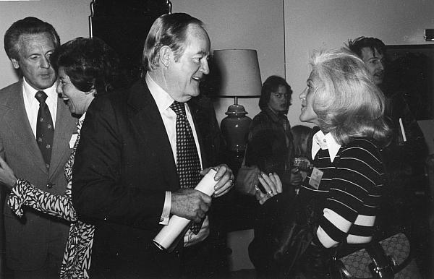
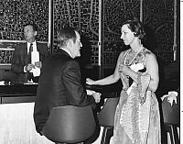
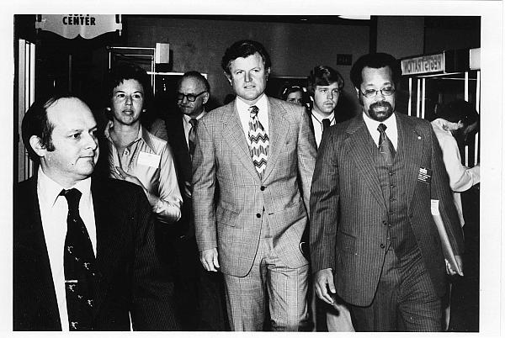
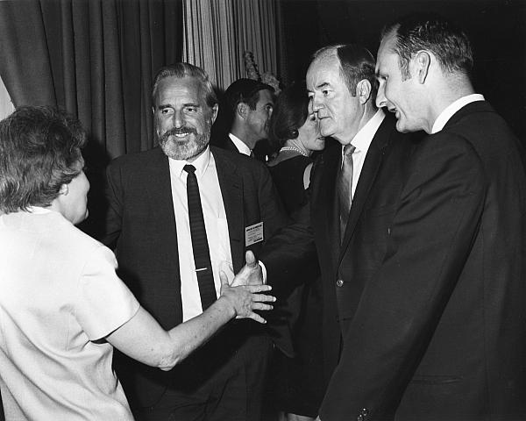
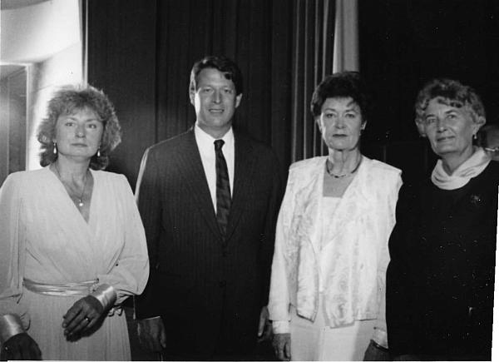
Remember when political leaders came to ASIS?
Notes:
Left and center: Hubert H. Humphrey in 1969. Upper left—chatting with Susan Artandi. Lower left: at a reception with Phyllis Baxendale, Doug Englebart, and Charlie Bourne. That was the same year that Doug Engelbart did his first public demonstration of his new invention—the mouse. In 1975, a young Ted Kennedy came and spoke at an ASIS meeting—he is shown here with the Executive Director, Josh Smith. Lower right: it is 1982 and Al Gore came to speak, and was photographs with Toni Carbo, [unidentified woman], and Ann Prentice (who was then from Gore’s home state of Tennessee).

Slide 11
Notes:
Now to look back even further….to the year 1961, to get a clearer idea of the membership and makeup of ADI at that time. In 1961, there were about 800 or so members, and each was listed in a directory printed within the pages of the October American Documentation issue. Those of you who have been in the field will recognize quite a few of their names and accomplishments, even though more than 50 years have passed.

Slide 12
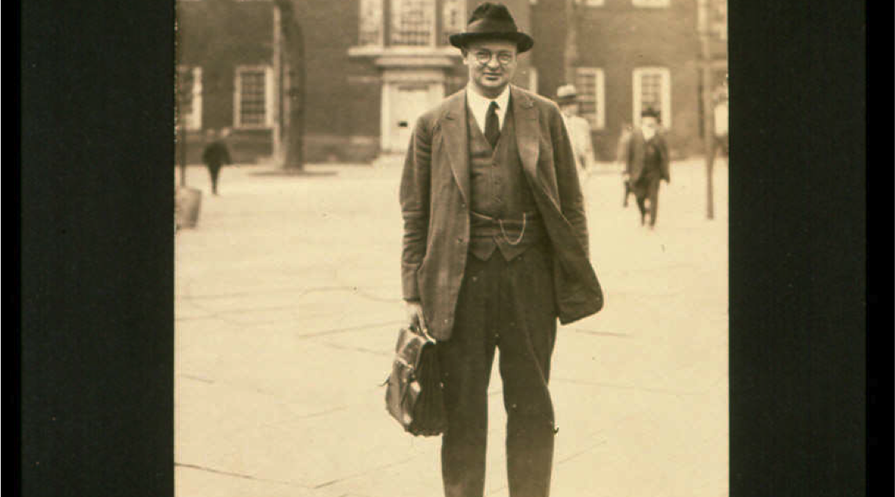
Watson Davis, founder of ADI
Notes:
Let’s run through some of those names on the list. We have to start of course, with Watson Davis, the founder and first president of ADI. Known widely for devising methods for popularizing the study of science, Watson’s afilliation was with Science Service, an organization established by the American Association for the Advancement of Science, the National Academy of Science, and the National Research Council. His many contributions to ADI and to the field of library and information science are commemorated every year by the Watson Davis Award. Oddly enough, there are no candid shots of Watson in the ASIST Archives—only his official photo as president of ADI, and ASIST’s copy of it is badly deteriorated. So this picture is borrowed from the Watson Davis file stored on Bob Williams’ site at the University of South Carolina.

Slide 13
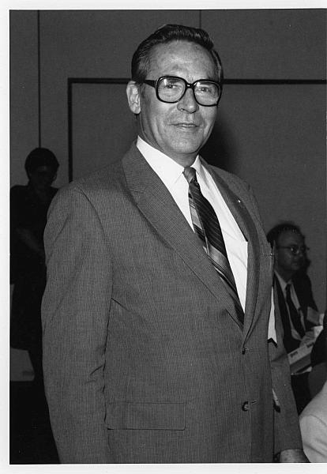
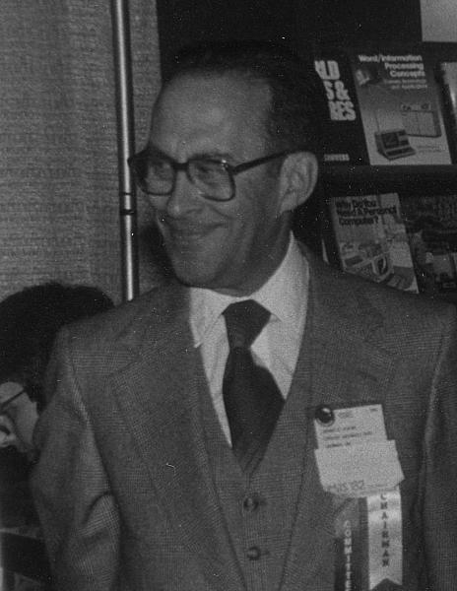
Dale Baker, Gerard Platau
Notes:
Next let’s move to the world of the A&I serivices, represented by these two who in 1961 were at Chemical Abstracts Service: Dale Bake (director) and Gerard Platau. Gerry was also a long-time ASIST parliamentarian.

Slide 14
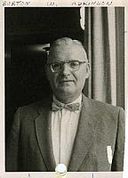
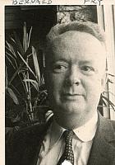
Burton W. Adkinson and Bernard Fry
Notes:
These two were from the government. Burt Adkinson and Bernie Fry, were the head and deputy head of the Office of Science Information at the National Science Foundation. Bernie Fry later became Dean of the library school at Indiana and an Award of Merit winner. Note that both of these pictures have been deliberately damaged, with the names written on the face and holes punched in the bottom as if they were being put in a notebook or catalog of some sort.

Slide 15
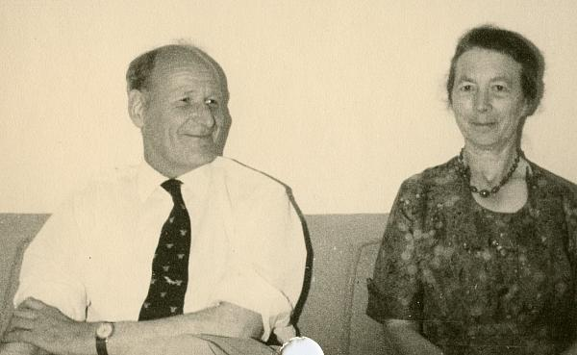
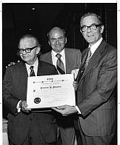
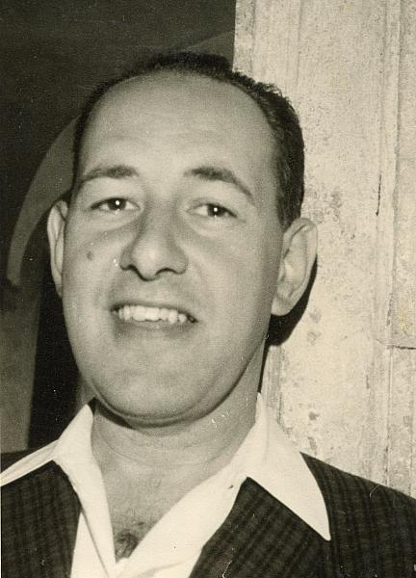

Robert A. Fairthorne, Gerard Salton, Ralph R. Shaw, Jesse Shera
Notes:
There were some academic researchers among the 1961 membership: Robert A. Fairthorne, pictured here informally with his wife Mona, was an English classificationist who came to ADI meetings to challenge prevailing ideas and attitudes of the day in information science; he eventually won the 1967 Award of Merit. Later well known for his SMART system, in 1961 Gerry Salton was at the Computation Lab at Harvard University. Jesse Shera—known to us all for so many things; in 1961 Jesse was Dean of the School of Library Science at Western Reserve University. Here he is pictured receiving the 1973 Award of Merit. In the center is a baby picture of Ralph Shaw—no! just kidding. The collections have no pictures of the original Ralph Shaw, who in 1961 would become widely known as an innovative librarian and publisher (founder of Scarecrow Press). In 1961 he was the dean of the library school at Rutgers University.

Slide 16
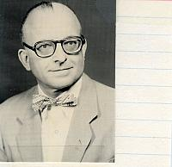
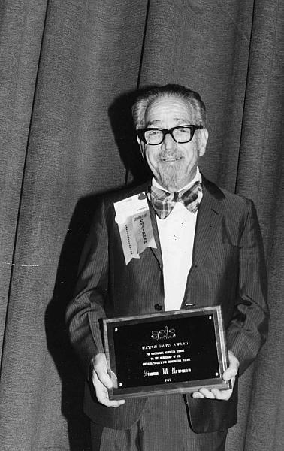
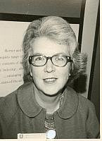
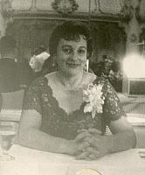
Saul & Mary Herner, Calvin Mooers, Simon Newman, Claire K. Schultz
Notes:
Some of the “class of 61” were working in companies or as consultants. Unfortunately we don’t have a picture of Saul Herner. He was a librarian by background—but by 1961 he and his wife Mary were running their own company in (Herner & Company), that did research under contracts with the government as well as conducting informational surveys and designing information systems for private organizations. Mary was born in Scotland and came to the U.S. in 1953. She was a physics honors graduate and was proficient in French, German, Spanish, Russian and Japanese and studied Latin and ancient Greek. Calvin Mooers was well known by 1961 for having coined the term "information retrieval" in 1950 and also the term "descriptors." He was the son-in-law of Watson Davis. In 1961 he was running his own information management company, the Zator Company. Si Newman identified himself in 1961 as simply, “Documentation Consultant, Washington DC.” Si was a long-time parliamentarian of ASIS and also the photographer behind hundreds of these early pictures. He wasn’t very good and he was very short—so the pictures are often out of focus and almost always taken looking up at the subject. In 1961, Claire Schultz was the president-elect of ADI, the first woman president!, but her day job was at UNIVAC, which led her as consultant right about that time to the first computerization of MEDLARS.

Slide 17
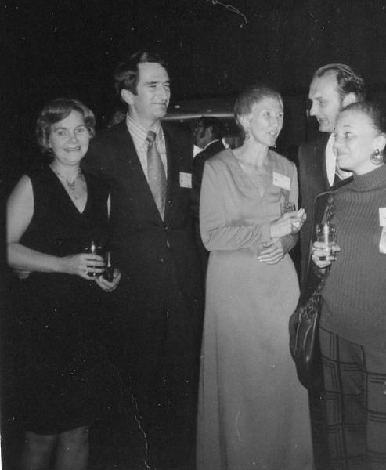
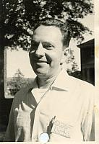
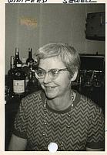
Harold Borko, Ben-Ami Lipetz, Winifred Sewell
Notes:
Here are more of those who in 1961 were working in a company, often doing R&D work. HalHarold (Hal) Borko, research scientists at System Development Corporation, which in 1961 was 10 years away from launching their ORBIT Search System and developing a similar system for NLM called MEDLINE. Ben-Ami Lipetz is known to many of us through his historical research and activities in ASIST and as a professor at SUNY-Albany, but in 1961 Ben was Head of the Systems Applications Section, Itek Corporation. Here he is pictured with his wife at a reception. In 1961 Win Sewell was transitioning from being a senior librarian at Squibb, to the NLM as deputy chief and subject heading specialist in the Bibliographic Services Division. Her work was instrumental in the development of MEDLARS. Note again the holes punched in Hal’s and Win’s photos.

Slide 18
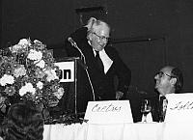
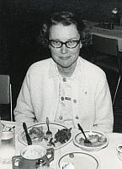
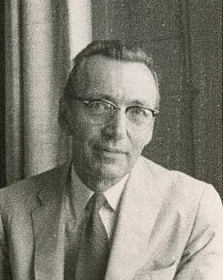
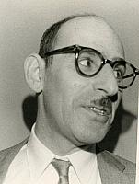
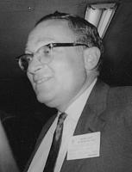
Scott Adams, Frederick Kilgour, Phyllis Richmond, Gerald Sophar, Herbert S. White
Notes:
Now to the last group—those who in 1961 were librarians. Scott Adams was deputy director at NLM who would later be a key player in developing the MEDLARS systems. Fred Kilgour is remembered of course as the founder of OCLC in 1967; in 1961 he was the Head of Medical Library at Yale. This picture shows him receiving the 1979 Award of Merit
Phyllis Richmond had already distinguished herself as a leading classification researcher. She was founder and president of the Classification Research Study Group in the late 1950’ but in 1961 she was a science librarian at the University of Rochester. In 1961 Gerry Sophar was working at the National Agriculture Library where he became an expert in copyright law. Later he served as president of ASIS. Earlier, after World War II, Gerry worked for the U.N. Relief and Rehabilitation Administration in the displaced persons camps in occupied Germany. He became chief of police in the Regensburg sector of the country and helped separate former Nazis from other refugees. That experience led him to serve as an expert witness for Justice Department prosecutors who brought cases against Nazis wrongly admitted to the United States. Herb White later became Dean of the library school at Indiana, but in 1961 he was head of the Engineering Library at IBM.

Slide 19
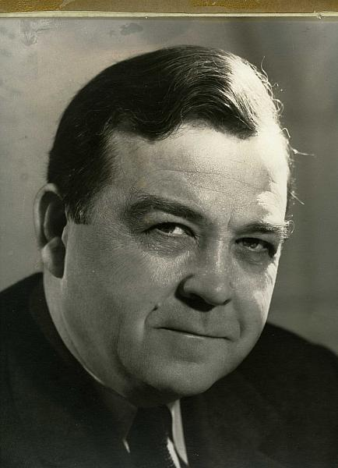
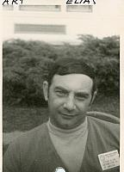
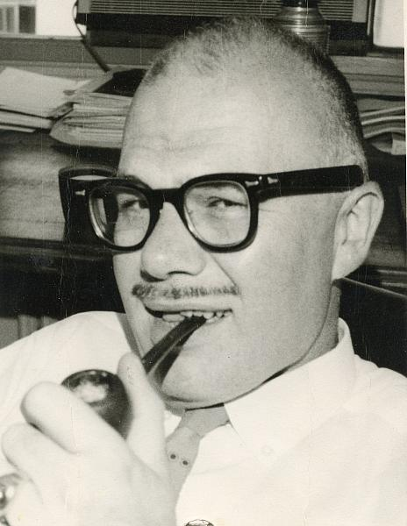
Art Elias, Luther Evans, Harold Wooster
Notes:
Three more librarians: First, Arthur Elias…..

Slide 20
Characteristics of this 1961 sample of 26
4% from organizations/associations (Watson Davis)
8% from A& I
8% from government agencies (not federal libs)
15% were academics
31% were librarians
35% from companies or were consultants
Notes:
were from A& I
Xx were from government agencies (not federal libs)
4% from organizations/associations (Watson Davis)
8% from A& I
8% from government agencies (not federal libs)
15% were academics
31% were librarians
35% from companies or were consultants
A very different composition of membership than exists in ASIST today!!

Slide 21
Where we are
We can be thankful that HQ staff held on to them through many office moves, and bothered to scrawl information on them, or file them in some logical way.
Photos are on the ASIST Web site, behind a password: http://www.asis.org/gallery3/index.php/
Best access and manipulation is with Chrome browser
Gallery3 can be searched by keywords, names
2,626 photos total; more could easily be added. 25 pictures came from the Bentley Library Archives at Michigan. Are there other sources?
Many pictures need more and better metadata
What next????
Notes:
http://www.asis.org/gallery3/index.php/

