Slide 1
Oral Histories of Information Science Pioneers and Leaders
This project has had two phases:
1. Identifying oral histories of IST pioneers/leaders done by others
2. The ASIST 75th anniversary oral history program
As of November, 2013 I have identified a total of at least 50 IST oral histories. This list has been posted to the ASIST history site and will be regularly updated.

Slide 2
Phase 1 of the IST Oral histories program: Non-ASIST oral histories
This is an ongoing project! If you know of any not on the list on the ASIST Web site please let me know!
Creators of these oral histories include:
1. Universities, institutions, individuals
2. Professional organizations
3. Chemical Heritage Foundation
4. Youtube collections (by many different folks)
I have identified about 40 of these interviews.
We hope to include all of these interviews of the ASIST Web Oral History Portal (more on this later)

Slide 3
Phase 2: the ASIST 75th Anniversary Oral history project
Began two years ago. Funded by ASIST and the Univ. of South Carolina-SLIS, and volunteers.
Intended to be ongoing, depending on funding and the help of volunteers.
As of Nov., 2013, approx. 10 have been completed and approx 10 are almost finished. Another 20 are in the planning stage, mostly needing volunteers to help with interviewing, transcribing, and doing background research.

Slide 4
Phase 2: the ASIST 75th Anniversary Oral history project (2)
How are we doing the project?
1. Individuals identified by the 75th Task Force
2. Priority is on folks retired or near retirement
3. Permission of the interviewee to participate
4. Extensive background work done on each person with assistance of interviewee
5. Find a volunteer interviewer, preferably experienced in oral history work; audio/video interview
6. Conduct the interview, transcribe it, review/edit by the interviewee; sign final release form

Slide 5
Phase 2: the ASIST 75th Anniversary Oral history project (3)
How are we doing the project? (continued)
7. Interviewee may grant various levels of release on the release form: completely open; limited sections restricted for specified period; permission to quote or not for specified period; totally restricted for specified period.
8. Release form includes attention to transcript, audio or video file, vita/resume, etc.
9. All materials related to the interview to be deposited with the ASIST archives at U. Michigan, depending on permission of interviewee
10. Include in the ASIST Oral History Web Portal

Slide 6
The ASIST Oral History Web Portal: Progress Report
Funded by ASIST and USC/SLIS. Official property of ASIST.
Project developed by Elise Lewis’ SLIS 777 class, Fall, 2013. Includes 13 MLIS and Ph.d. students. Grant Robertson, GA.
Content management software: Word Press, ADA compliant.
Metadata: Dublin Core, modified with oral history elements. Susan Rathbun-Grubb, metadata advisor.
Documentation manual in development.
Scheduled to go live Dec. 12.

Slide 7
The ASIST Oral History Web Portal: Progress Report (2)
Website home (draft)

Slide 8
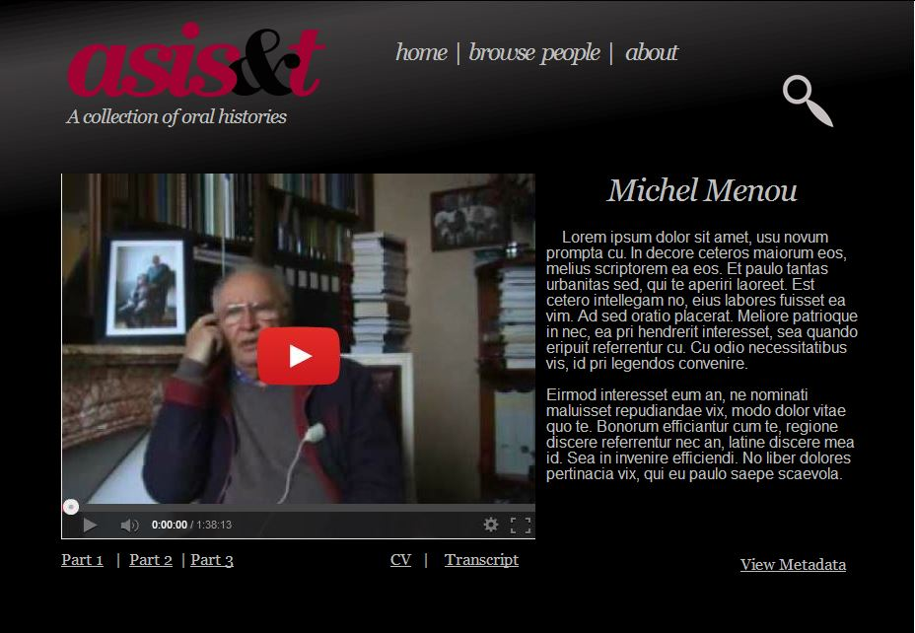
The ASIST Oral History Web Portal: Progress Report (3)

